Slide 1
AI2C Course Intro

Slide 2
Agenda
Scheduling
Introductions

Slide 3
Course Structure
Summer prep
CMU course
AI2C specifics

Slide 4
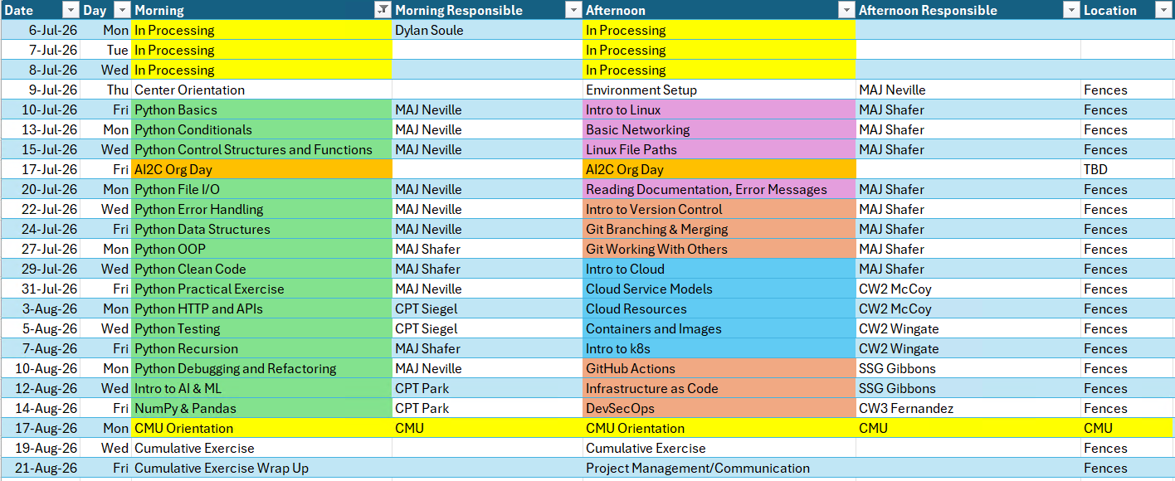
Summer Schedule

Slide 5
CMU Schedule - Fall

Slide 6
CMU Schedule - Spring

Slide 7
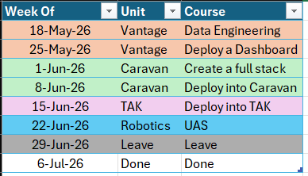
AI2C Specifics - TBD

Slide 8
Daily Schedule
0900 – UTC – Morning class
1300 – UTC – Afternoon class

Slide 9
Instructor Intros

Slide 10
Class Intros
Name
Rank
What you do in the Army
Where you're coming from
Your experience level with AI/Tech/Coding

Slide 11
Expectations
College courses
Python experience
DevOps
Cloud
Garbage in, garbage out
Do the material
Optional exercises
Accelerated program, no spoon-feeding
Academic Freedom / Equality
What do you want out of this?

Slide 12
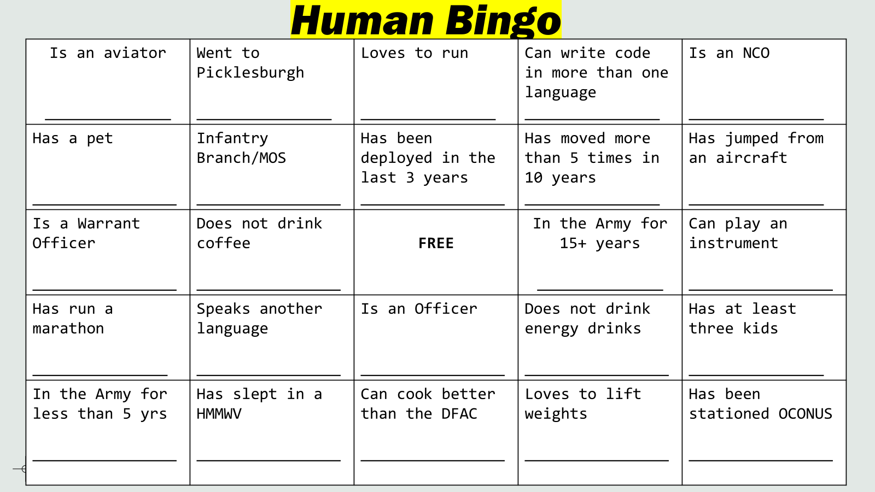
Icebreaker - Human Bingo

Slide 13
Questions

